Slide 1
Tank 2020
Group 4
Team member:
Yunlei Lyu
Yangfan Wang
Jia Qi Zhao

Slide 2
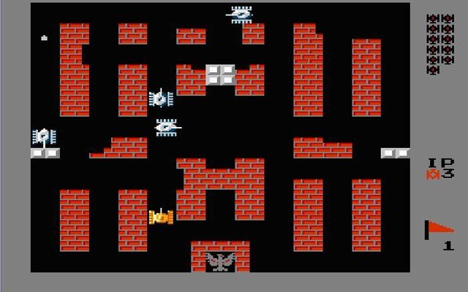
Our Project
An Intuitive & Interactive
Classic 2D Video Game
Notes:
Let me remind you guys with our project idea. As our team members all had a strong interest in the classic 2d games and we would like to bring them back that we still play them easily, we proposed the idea of the Recreation of the Game Tank 1990

Slide 3
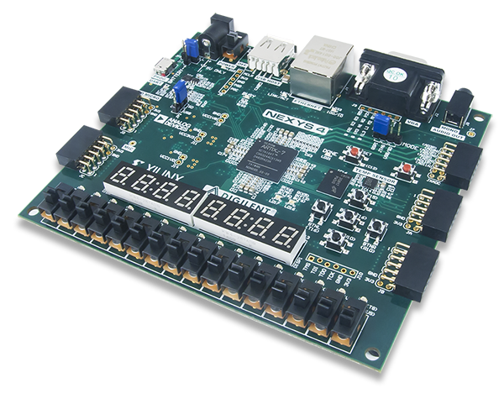

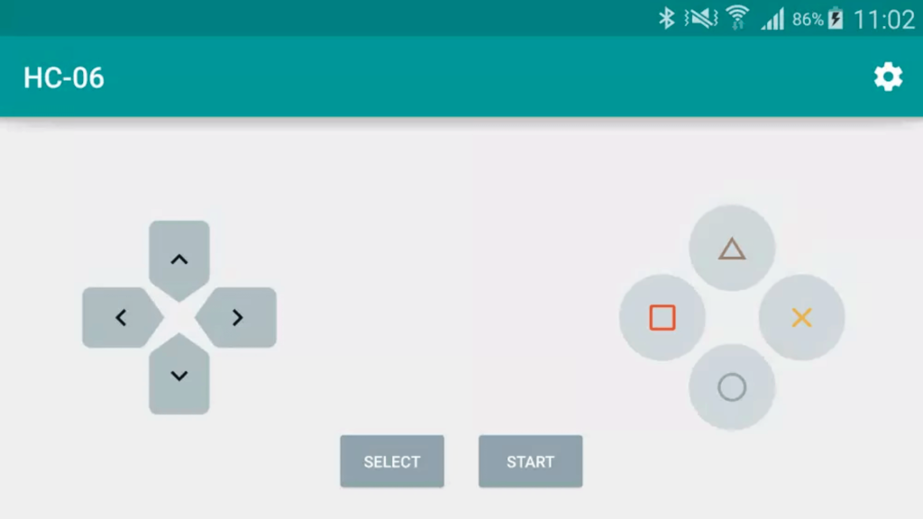
Better Solution for Classic Games
FPGA
Bluetooth Controller on Mobile Phone
Monitor
Notes:
Our team would like to make it a better solution for the general classic games. We would like to abandon those expensive hardware, but using only a FPGA board, a bluetooth controller on mobile and a monitor to realize a high quality game

Slide 4
How to Play ?
Control the Tank from Mobile Phone
Fire Shelles to Attack Others or Destroy Walls
Avoid Enemy’s Shell
Protect Your Base
Notes:
The game itself, we would like to make it intuitive but attractive. The game logic is straight forward, as the player only needs to control the tank and avoid attack from the enemy while they can attack opponents and destroy walls.

Slide 5
HDMI High Resolution Display
Computer Enemy
Map Configurations
Notes:
Here are some highlights we would like to achieve in the project. We would like to use HDMI to realize a high resolution at 1080 and solid refresh rate. Also we will bring in the AI enemy instead of purely user vs user mode to make the game more interactive. Last, we would set up the battleground with walls and provide the user with better experience when they can destroy the walls.

Slide 6
Initial Thoughts
Bluetooth Control
Display at minimum 640 * 480 @ 30 fps
2 Types of Walls
Have complete game logic
Smooth Tank Movements and Shell Firing
Collision Determination
Game-over Determination
A basic moving AI tank
Notes:
So here are our initial thoughts and goals on the project. It should take bluetooth input control signal and output to monitor with at least 640 by 480 at 30fps and we actually achieve higher in our project. We want to bring a smooth motion of all the moving objects. About the game, to confine the development complexity, we only wanted to include base map setup, a determination logic and moving AI tank.

Slide 7
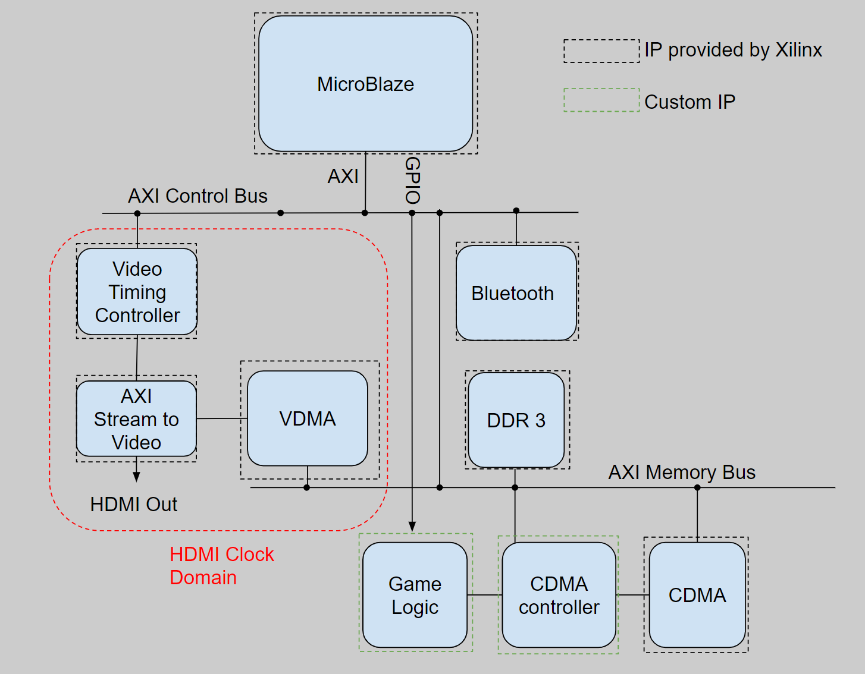
System Level Block Diagram
Player controls via Bluetooth.
Output via HDMI 1920x1080 @ 60Hz

Slide 8
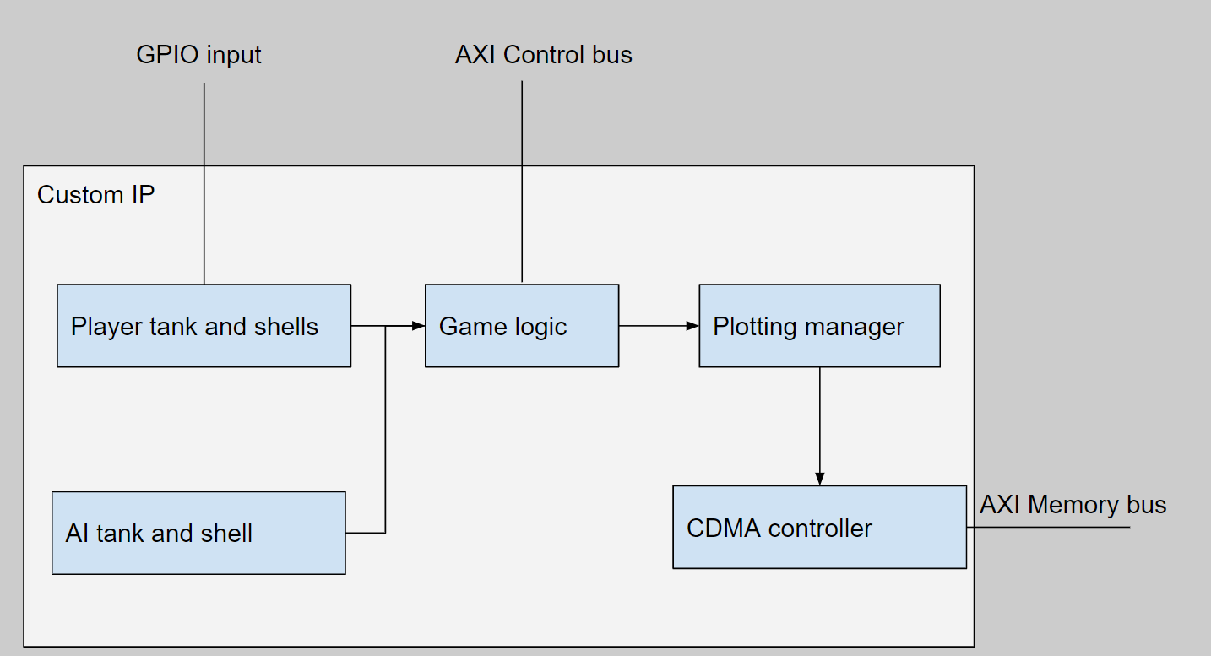
Custom IP block diagram

Slide 9
Problems encountered and changes made
Only support 1 enemy tank
Only support 1 shell from each tank at the same time
Increase the number of tanks increase the number of comparing logic quadratically - failed timing
Only support 1 type of wall
Reduce the size of register array for the map.
Simplify the game logic for higher refresh rate.

Slide 10
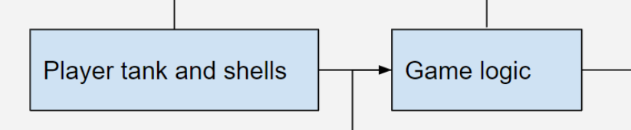
Custom - Game logic
Player tanks and shells
Game logic:
Store the game map.
Determine if the player can move its tank.
Determine if the player/enemy is hit.
Determine if the shell hits a wall.
Player tank and shells:
Using the bluetooth input to calculate the next tank position
Calculate next shell position based on current tank and shell position

Slide 11
Custom - Plotting Manager
An arbiter with priority
Ensure different objects can be updated
Control the order of plotting
Prioritize the player movements
Tanks
Shells
Walls
Player & Enemy
Notes:
Regarding the plotting manager, as we have multiple moving objects to update simultaneously, we don’t want to skip any movements especially the user inputs. We wanted the game looks smooth and without the weird jumps of images. So we designed a small plotting manager. It takes requests for all the objects and new addresses from the game logic. It keeps the ones without grant in wait and sends the update signal for the current processing one to the CDMA controller. By doing that, we can serialize the requests and make CDMA controller handle image plotting one at a time.

Slide 12
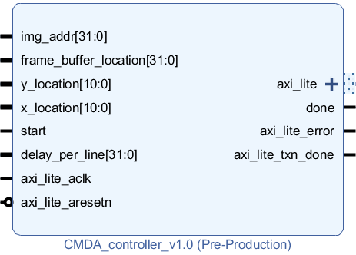
Custom IP - CDMA Controller
Responsible for moving the images of game elements stored in DDR memory to a desired location on screen.
Inputs:
Source image address location.
Location of frame buffer (for potential double buffer).
Pair of (X,Y) coordinate on the screen.
Start signal.
Delay between scan lines.

Slide 13
Custom IP - CDMA Controller
Outputs:
AXI Lite interface for controlling the AXI CDMA IP.
Handshake signal between Game Logic IP

Slide 14
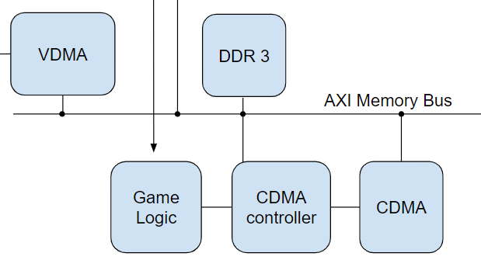
Custom IP - CDMA Controller
Detail Functionality:
Responsible for moving desired game blocks stored inside the DDR memory using continuous memory space to frame buffer that is continuous along horizontal scan line.
i.e. a 120 x 120 pixel game element would need 120 individual CDMA programming to move the picture into desired location in frame buffer.
Contains a FSM in charge of CDMA programming sequence via AXI_Lite interface.
When CDMA reports an error status, the controller can perform a soft reset and continue the operation.
Variable delay inserted between each individual CDMA programming for allowing the downstream VDMA to access the frame buffer at the same time.
congestion

Slide 15
Design Process
To Guarantee success the team followed the steps below:
Non technical side:
Early research into the various individual elements:
Break problem into blocks like: Bluetooth, HDMI, Game Logic .
Take advantage of reading week.
Set reasonable team goal and schedule.
Pairwise programming technique - assign two team members to research and develop on the same block.
Allocated spare time between milestones.

Slide 16
Design Process
To Guarantee success the team followed the steps below:
Technical side:
Take advantage of the testbench simulation:
Much faster design turnaround time.
Perform simulation at module, IP and system level.
Verify the core functionality at module level.
Verify the compliance with interface protocol at IP level.
Check for overall system behavior at system level.
Levage ILA after implementation.
Simulation is not perfect. This is always unexpected system level bug.
Connect ILA to critical interfaces to check the behavior of each IP.
Clear interface definition between custom IPs.
Define handshake mechanism before the developments of the actual IP.

Slide 17
Lesson Learned
The important lessons we have learned along the journey:
Technical
Industry standard AXI interface for communicating between IPs.
Perform design verification using testbench, VIP and test sequences.
Hands on experience with Xilinx design tool.
Non technical
Team coordination between multiple designers.
Techniques of executing project according to timeline.
Assign task according to personal interest.
Notes:
On the technical side we have learned are: 1st Understand and implement industry standard AXI interface for communicating between our custom IP and provided IPs.
2nd learned how to effectively and efficiently use testbench, verification IP and test sequences to perform design verification before compile the final implementation on FPGA and found out it’s not working. 3rd All of us have gained a lots of hands on experience with Xilinx and Vivado design tool in this project, without them the team is impossible to finish this project on time.
On the non technical side we have learned how to coordinate between multiple team members by setting up internal communication mechanism that all team members would response to it quickly.
Execute project according to timeline by having multiple small sync up meeting with relative parties to ensure the execution of the project follows predefined timeline, and also allocate extra time in between milestones so if unexpected outcomes do happen, the team can still finish the task on time.

Slide 18
Conclusion

